Slide 1

TASK-3
TOPIC–
TO FIND AND REPORT THE CRITICAL VULNERABILITIES USING PAYLOADS
🐞 http://testasp.vulnweb.com/🐞
NAME: Naveen Kumar A
E-MAIL: naveenkumar.ct19@bitsathy.ac.in

Slide 2

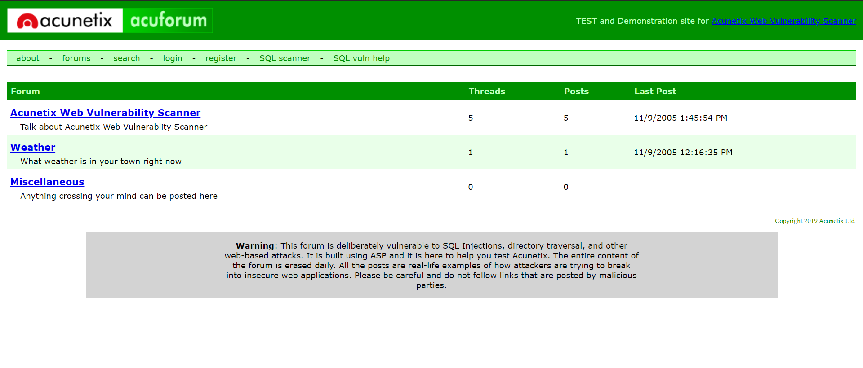



WEBSITE INFORMATION
WEBSITE URL- 🐞 http://testasp.vulnweb.com/🐞

Slide 3



REPORT
Tittle – cross site scripting
Domain – vulnweb.com
Sub-Domain – testasp.vulnweb.com
STEPS – http://testasp.vulnweb.com/🐞 🐞
Step 1: Visit http://testasp.vulnweb.com/
Step 2: On the top menu you will find a search option.
Step 3: Click on it and you will be prompted with the Search box.
Step 4: You can intercept the request in Burp Suite
Step 5: Now you can find different payloads for XSS.
Step 6: Send the request to the intruder and paste all the payloads.
Step 7: Try to find a successful payload for XSS.

Slide 4
IMPACT
XSS can have huge implications for a web application and its users. User accounts can be hijacked, credentials could be stolen, sensitive data could be exfiltrated, and lastly, access to your client computers can be obtained.
It can lead to steal all of your user data and it can harmful for your company/website.
It is an simple task for attackers to exploit cross site scripting. By injecting malicious script in to un secure or un-validate browser-supplied input the attacker cause the script returned by the application and executed by the browser. This could allow it to take control of the application ‘s functionality ,manipulate data or plant additional malicious code.

Slide 5
REMEDY
If you want to prevent your website to be vulnerable of cross site scripting then you should enable noscript on browser
Encode data on output. At the point where user-controllable data is output in HTTP responses, encode the output to prevent it from being interpreted as active content. Depending on the output context, this might require applying combinations of HTML, URL, JavaScript, and CSS encoding.
Use appropriate response headers. To prevent XSS in HTTP responses that aren't intended to contain any HTML or JavaScript, you can use the Content-Type and X-Content-Type-Options headers to ensure that browsers interpret the responses in the way you intend.
POC including screenshot /screen recording is include in the report which is attached bekow.

Slide 6
SCREENSHOT

Slide 7
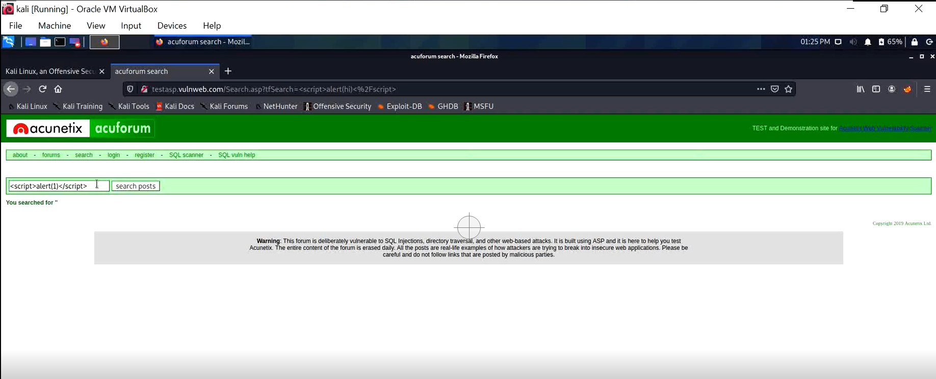

Slide 8
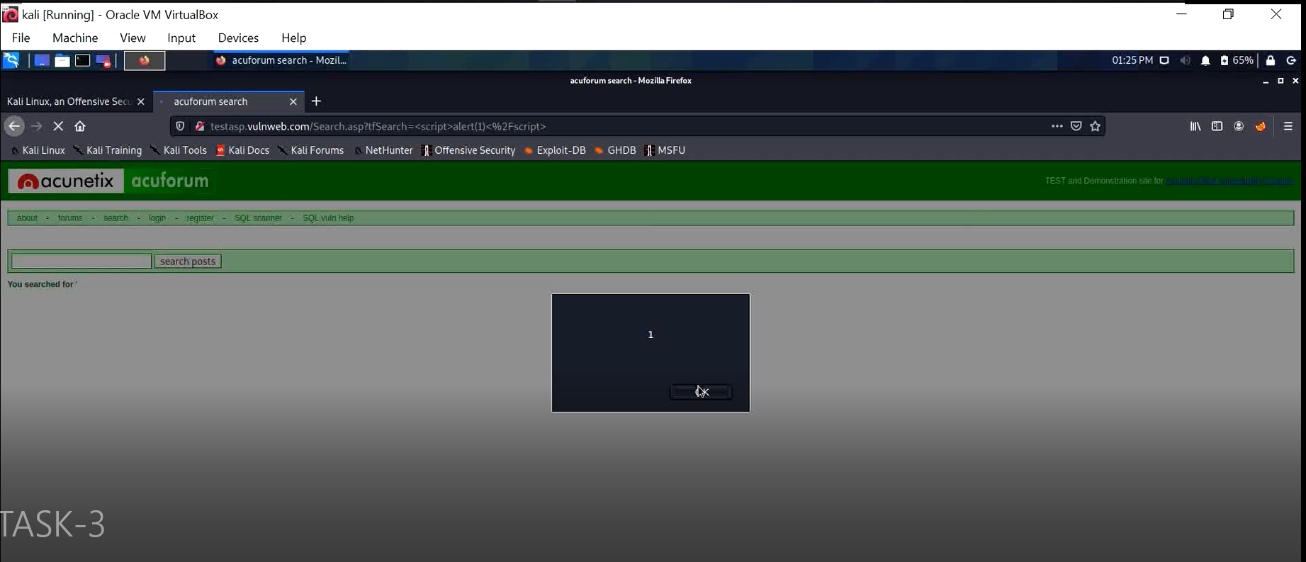

Slide 9
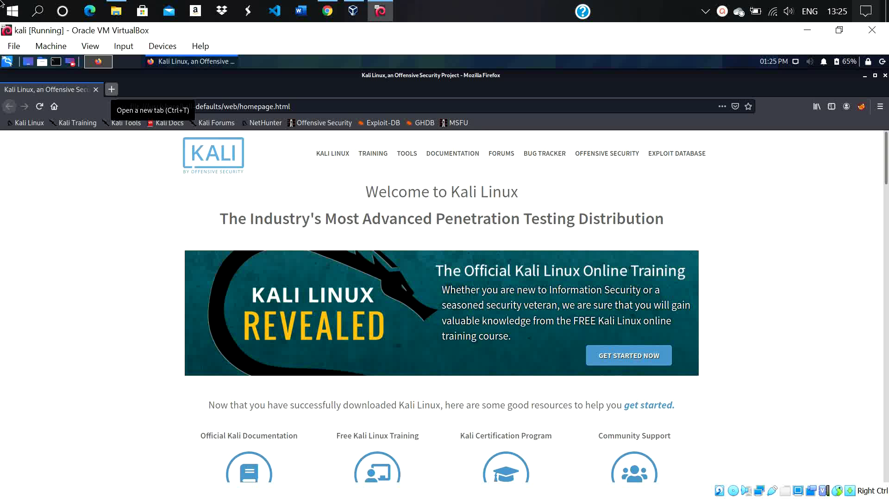
POC VEDIO

